Slide 1

Validating Component Properties

Slide 2
Objectives
What are PropTypes? How to use PropTypes
Knowing what to expect
Simple property validators
Type and value validators
Writing custom property validators

Slide 3
What are PropTypes?
PropTypes are simply a mechanism that ensures that the passed value is of the correct datatype.
This makes sure that we don’t receive an error at the very end of our app by the console which might not be easy to deal with.
PropTypes is provided by the prop-types package and can be used in both class components and function components.

Slide 4
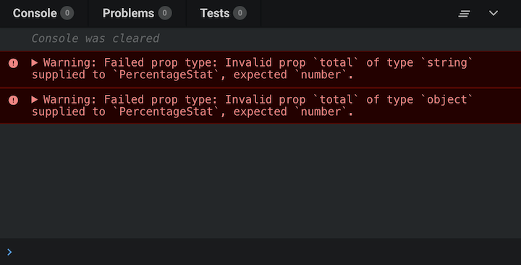
How to use PropTypes
To use PropTypes, need to install the prop-types package:
npm install prop-types@15.8.1
/** FUNCTIONAL COMPONENTS */
function ReactComponent(props) {
// ...implement render logic here
} ReactComponent.propTypes = {
// ...prop type definitions here
}
/** CLASS COMPONENTS: METHOD 1 */
class ReactComponent extends React.Component {
// ...component class body here
} ReactComponent.propTypes = {
// ...prop type definitions here
}
/** CLASS COMPONENTS: METHOD 2
* Using the `static` class properties syntax */
class ReactComponent extends React.Component {
// ...component class body here static propTypes = {
// ...prop type definitions here
}
}
When props are passed to, they are checked against the type definitions configured in the propTypes property. When an invalid value is passed for a prop, a warning is displayed on the JavaScript console:
import React from 'react';
import { PropTypes } from "prop-types";
const Count = (props) => {
return (
<>
.........
</>
)
};
Count.propTypes = {
//// key is the name of the prop and
// value is the PropType
}
export default Count;

Slide 5
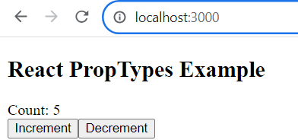
import { useState } from "react";
import Count from "./Count";
function App() {
const [count, setCount] = useState(0);
const handleIncrement = () => {
setCount(count + 1);
console.log('Increment');
};
const handleDecrement = () => {
setCount(count - 1);
console.log('Decrement');
};
return (
<div className="App">
<h1>React PropTypes Example</h1>
<Count count={count} increment={handleIncrement} decrement={handleDecrement} />
</div>
);
}
export default App;
import React from 'react';
import PropTypes from 'prop-types';
const Count = (props) => {
return (
<>
<div>Count: {props.count}</div>
<button onClick={props.increment}>Increment</button>
<button onClick={props.decrement}>Decrement</button>
</>
);
};
Count.propTypes = {
count: PropTypes.number.isRequired,
increment: PropTypes.func.isRequired,
decrement: PropTypes.func.isRequired
};
export default Count;

Slide 6
Knowing what to expect
Property validation in React components is like field validation in HTML forms.
The key aspect of property validation is knowing what's passed into the component as a property value.
When property validation fails, you know that something was provided as a component property that shouldn't have been. It's a matter of finding where the value is passed in the code and fixing it.

Slide 7
Simple property validators
How to use the simple property type validators available in the prop-types package.
How to accept any property value as well as to make a property required instead of optional.
Include:
Basic type validation
Requiring values
Any property value

Slide 8
Basic Types of PropTypes
Below is the list of all data types that are considered primitive or the basic ones with their classes that we can use to check props.
Type | Class | Example
String | PropType.string | “helllo”
Object | PropType.object | {name: “Rohit”}
Number | PropType.number | 10
Boolean | PropType.bool | true/false
Function | PropType.func | const say = {console.log(“hello”)}
Symbol | PropType.symbol | Symbol(“m”)

Slide 9
Basic type validation
import * as React from "react";
import PropTypes from "prop-types";
function MyComponent({
myString,
myNumber,
myBool,
myFunc,
myArray,
myObject,
}) {
return (
<section>
<p>{myString}</p>
<p>{myNumber}</p>
<p><input type="checkbox" defaultChecked={myBool} /></p>
<p>{myFunc()}</p>
<ul>
{myArray.map((i) => (
<li key={i}>{i}</li>
))}
</ul>
<p>{myObject.myProp}</p>
</section>
);
} MyComponent.propTypes = {
myString: PropTypes.string,
myNumber: PropTypes.number,
myBool: PropTypes.bool,
myFunc: PropTypes.func,
myArray: PropTypes.array,
myObject: PropTypes.object,
}; export default MyComponent;
Let's take a look at validators that handle the most primitive types of JavaScript values. You will use these validators frequently, as you'll want to know whether a property is a string or a function

Slide 10
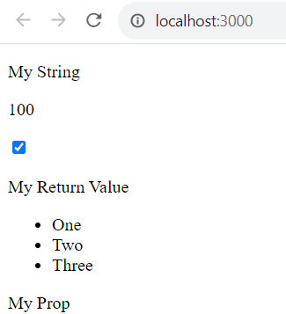
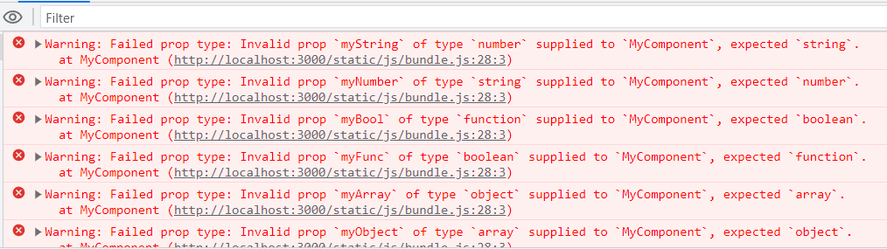
Basic type validation – cont’d
import React from 'react';
import ReactDOM from 'react-dom/client';
import MyComponent from './MyComponent';
const root = ReactDOM.createRoot(document.getElementById('root'));
const validProps = {
myString: "My String",
myNumber: 100,
myBool: true,
myFunc: () => "My Return Value",
myArray: ["One", "Two", "Three"],
myObject: { myProp: "My Prop" },
};
const invalidProps = {
myString: 100,
myNumber: "My String",
myBool: () => "My Reaturn Value",
myFunc: true,
myArray: { myProp: "My Prop" },
myObject: ["One", "Two", "Three"],
};
function render(props) {
root.render(<MyComponent {...props} />);
}
render(validProps);
//render(invalidProps);

Slide 11
Requiring values
import React from 'react';
import ReactDOM from 'react-dom/client';
import MyComponent from './MyComponent';
const root = ReactDOM.createRoot(document.getElementById('root'));
const missingProp = {
myString: "My String",
myNumber: 100,
myBool: true,
myFunc: () => "My Return Value",
myArray: ["One", "Two", "Three"],
};
function render(props) {
root.render(<MyComponent {...props} />);
}
render(missingProp);
The PropTypes functions have a tool that lets you specify that a property must be provided, and it must have a specific type
MyComponent.propTypes = {
myString: PropTypes.string.isRequired,
myNumber: PropTypes.number.isRequired,
myBool: PropTypes.bool.isRequired,
myFunc: PropTypes.func.isRequired,
myArray: PropTypes.array.isRequired,
myObject: PropTypes.object.isRequired,
};
Notes:
The isRequired value is appended to each of the type validators used. So, for instance, string.isRequired means that the property value must be a string and that the property cannot be missing. Let's put this component to the test

Slide 12
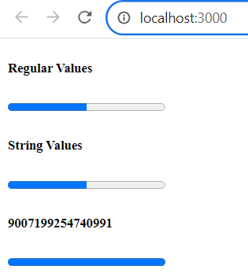
Any property value
import * as React from "react";
import PropTypes from "prop-types";
function MyComponent({ label, value, max }) {
return (
<section>
<h5>{label}</h5>
<progress {...{ max, value }} />
</section>
);
}
MyComponent.propTypes = {
label: PropTypes.any,
value: PropTypes.any,
max: PropTypes.any,
};
export default MyComponent;
It doesn't actually care what value it gets – anything is valid, including not passing a value at all.
Another reason to have the any property validator is for the sake of consistency
import React from 'react';
import ReactDOM from 'react-dom/client';
import MyComponent from './MyComponent';
const root = ReactDOM.createRoot(document.getElementById('root'));
root.render(
<section>
<MyComponent label="Regular Values" max={20} value={10} />
<MyComponent label="String Values" max="20" value="10" />
<MyComponent label={Number.MAX_SAFE_INTEGER} max={new Date()} value="10" />
</section>
);

Slide 13
Type and value validators
About the element and node validators that check for values that can be rendered inside HTML markup.
How to check for specific types, beyond the primitive type checking that you just learned about.
Implement validation that looks for specific values.
Include:
Things that can be rendered
Requiring specific types
Requiring specific values

Slide 14
Things that can be rendered
Sometimes, you just want to make sure that a property value is something that can be rendered by JSX markup.
For example, if a property value is an array of plain objects, this can't be rendered by putting it in {}. You have to map the array items to JSX elements.
This sort of checking is especially useful if your component passes property values to other elements as children

Slide 15
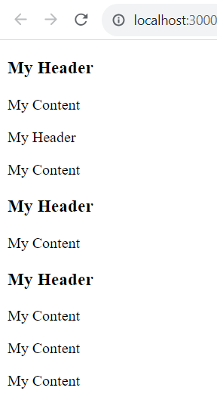
Things that can be rendered – cont’d
import React from 'react';
import ReactDOM from 'react-dom/client';
import MyComponent from './MyComponent';
const myHeader = <h1>My Header</h1>;
const myContent = <p>My Content</p>;
const root = ReactDOM.createRoot(document.getElementById('root'));
root.render(
<section>
<MyComponent {...{ myHeader, myContent }} />
<MyComponent myHeader="My Header" {...{ myContent }} />
<MyComponent {...{ myHeader }} myContent="My Content" />
<MyComponent
{...{ myHeader }}
myContent={[myContent, myContent, myContent]}
/>
</section>
);
import * as React from "react";
import PropTypes from "prop-types";
function MyComponent({ myHeader, myContent }) {
return (
<section>
<header>{myHeader}</header>
<main>{myContent}</main>
</section>
);
}
MyComponent.propTypes = {
myHeader: PropTypes.element.isRequired,
myContent: PropTypes.node.isRequired,
};
export default MyComponent;

Slide 16
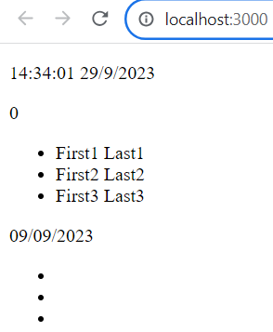
Requiring specific types
Sometimes, you need a property validator that checks for a type defined by your application
const id = (function* () {
let i = 1;
while (true) {
yield i;
i += 1;
}
})();
class MyUser {
constructor(first, last) {
this.id = id.next().value;
this.first = first;
this.last = last;
}
get name() {
return `${this.first} ${this.last}`;
}
}
export default MyUser;

Slide 17
Requiring specific types – cont’d
import * as React from "react";
import PropTypes from "prop-types";
import MyUser from "./MyUser";
function MyComponent({ myDate, myCount, myUsers }) {
return (
<section>
<p>{myDate.toLocaleString()}</p>
<p>{myCount}</p>
<ul>
{myUsers.map((user) => (
<li key={user.id}>{user.name}</li>
))}
</ul>
</section>
);
}
MyComponent.propTypes = {
myDate: PropTypes.instanceOf(Date),
myCount: PropTypes.oneOfType([PropTypes.string, PropTypes.number]),
myUsers: PropTypes.arrayOf(PropTypes.instanceOf(MyUser)),
};
export default MyComponent;
import React from 'react';
import ReactDOM from 'react-dom/client';
import MyComponent from './MyComponent';
import MyUser from './MyUser';
const users = [
new MyUser("First1", "Last1"),
new MyUser("First2", "Last2"),
new MyUser("First3", "Last3"),
];
const root = ReactDOM.createRoot(document.getElementById('root'));
root.render(
<section>
<MyComponent myDate={new Date()} myCount={0} myUsers={users} />
<MyComponent myDate="09/09/2023" myCount={false} myUsers={[1, 2, 3]} />
</section>
);

Slide 18
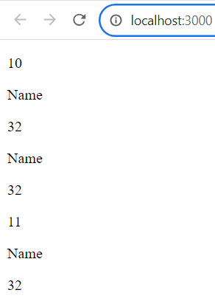
Requiring specific values
import * as React from "react";
import PropTypes from "prop-types";
const levels = new Array(10).fill(null).map((v, i) => i + 1);
const userShape = {
name: PropTypes.string,
age: PropTypes.number,
};
function MyComponent({ level, user }) {
return (
<section>
<p>{level}</p>
<p>{user.name}</p>
<p>{user.age}</p>
</section>
);
}
MyComponent.propTypes = {
level: PropTypes.oneOf(levels),
user: PropTypes.shape(userShape),
};
export default MyComponent;
import React from 'react';
import ReactDOM from 'react-dom/client';
import MyComponent from './MyComponent';
const root = ReactDOM.createRoot(document.getElementById('root'));
root.render(
<section>
<MyComponent level={10} user={{ name: "Name", age: 32
}} />
<MyComponent user={{ name: "Name", age: 32, online:
false }} />
<MyComponent level={11} user={{ name: "Name", age: "32"
}} />
</section>
);

Slide 19
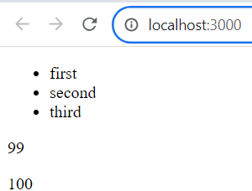
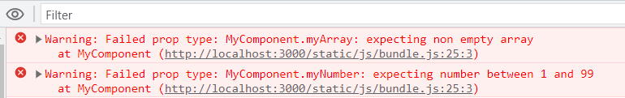
Writing custom property validators
function MyComponent({ myArray, myNumber }) {
return (
<section>
<ul>
{myArray.map((i) => (
<li key={i}>{i}</li>
))}
</ul>
<p>{myNumber}</p>
</section>
);
} MyComponent.propTypes = {
myArray: (props, name, component) =>
Array.isArray(props[name]) && props[name].length
? null
: new Error(`${component}.${name}: expecting non empty array`),
myNumber: (props, name, component) =>
Number.isFinite(props[name]) &&
props[name] > 0 &&
props[name] < 100 ? null : new Error(
`${component}.${name}: expecting number between 1 and 99`
),
};
export default MyComponent;
import React from 'react';
import ReactDOM from 'react-dom/client';
import MyComponent from './MyComponent';
const root = ReactDOM.createRoot(document.getElementById('root'));
root.render(
<section>
<MyComponent
myArray={["first", "second", "third"]}
myNumber={99}
/>
<MyComponent myArray={[]} myNumber={100} />
</section>

Slide 20
Exercise 19: Demo about Validation in Component

Slide 21
Summary
Concepts were introduced:
What are PropTypes? How to use PropTypes
Knowing what to expect
Simple property validators
Type and value validators
Writing custom property validators

